Slide 1
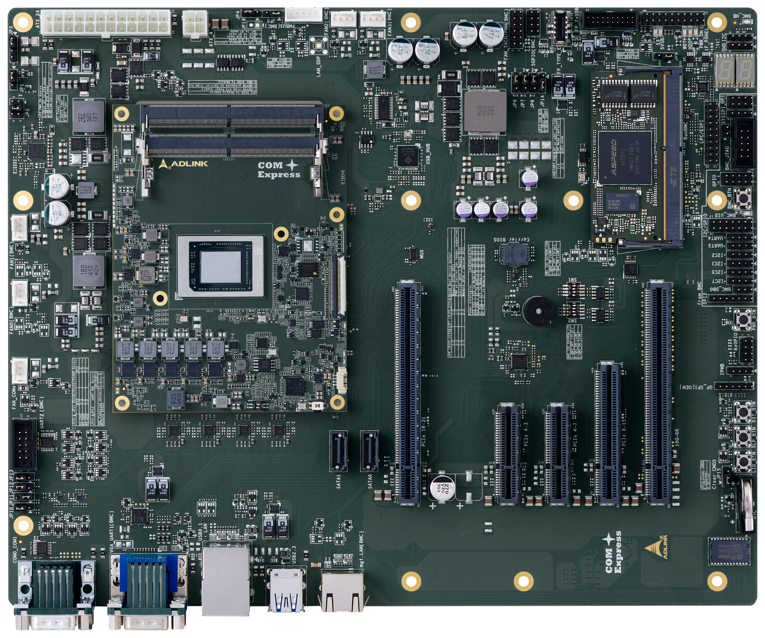
IPMI Interfaces
Use this one
A1
USB2 NG
FAN3
FAN2
FAN_TACH/PWM
BMC_LED
GPI
GPIO
FAN1
I2C/GPIO
UART3, UART4
I2C1, 2, 5, 7
FAN0
BMC_DBG
IPMB
UART2
UART1
VGA
mgt.
LAN

Slide 2
IPMI Interfaces
Use this one
FAN3
FAN2
FAN_TACH/PWM
BMC_LED
GPI
GPIO
FAN1
I2C/GPIO
UART3, UART4
I2C1, 2, 5, 7
FAN0
BMC_DBG
IPMB
UART2
UART1
VGA
USB2
(bottom)
mgt.
LAN

Slide 3
IPMI Interfaces
FAN3
FAN2
FAN_TACH/PWM
BMC_HB
SMB
I2C
GPI
LPC
GPIO
FAN1
I2C/GPIO
UART3/UART4
I2C1/2/5/7
FAN0
BMC_DBG
IPMB
UART2
COM1
(top)
UART1
VGA
USB2
(bottom)
mgt.
LAN

Slide 4
IPMI Interfaces
FAN3
FAN2
FAN_TACH/PWM
BMC_HB
SMB
I2C
GPI
LPC
GPIO
FAN1
I2C/GPIO
UART3/UART4
I2C1/2/5/7
FAN0
BMC_DBG
IPMB
UART2
COM1
(top)
UART1
VGA
USB2
(bottom)
mgt.
LAN

Slide 5
General Interface
Use this one
2xUSB
Front Panel
I2C
SMB
GPIO
PWM_BTN
FAN_COMe
RST_BTN
COM0
COM1
LAN
2x USB3
2x USB
2x SATA
PCIex8
(Gen4)
4x PCIe
(Gen4)
PCIex2
10G Ethernet card

Slide 6
General Interface
2xUSB
Front Panel
I2C
SMB
GPI
LPC
GPIO
PWM_BTN
FAN_COMe
RST_BTN
COM0
COM1
LAN
2x USB3
2x USB
2x SATA
PCIex8
(Gen4)
4x PCIe
(Gen4)
4x PCIe

Slide 7
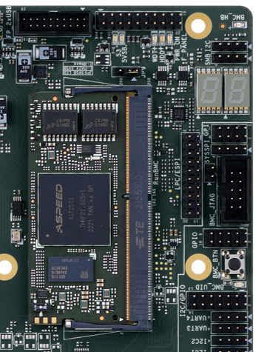
BMC LED
BMC HB
Use this one
BMC_LED
BMC_HB

Slide 8

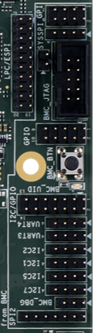
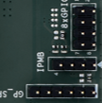
FAN_TACH/PWM
BMC_HB
I2C_2
FAN2
FAN3
I2C_6
GPI (ADC)
LPC
GPIO
I2C/GPIO
FAN1
FAN0
I2C_1, 2, 5, 7
BMC_DEBUG (UART console)
UART 3/4
UART2
IPMB
COM1
(upper)
UART1
VGA
USB2 (upper)
mgt.LAN
寫PWR_BTN, RST_BTN然後說跟HOST相關

Slide 11
gpi

